Slide 1
Software Test Procedures and Methodologies
MAD 5234

Slide 2
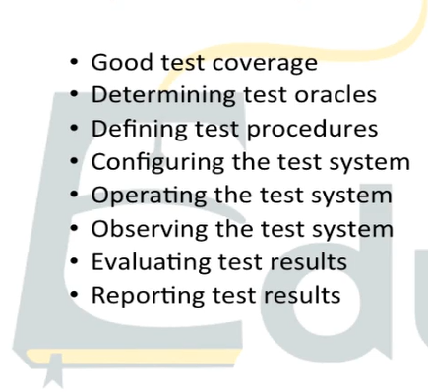
Testing Lifecycle

Slide 3
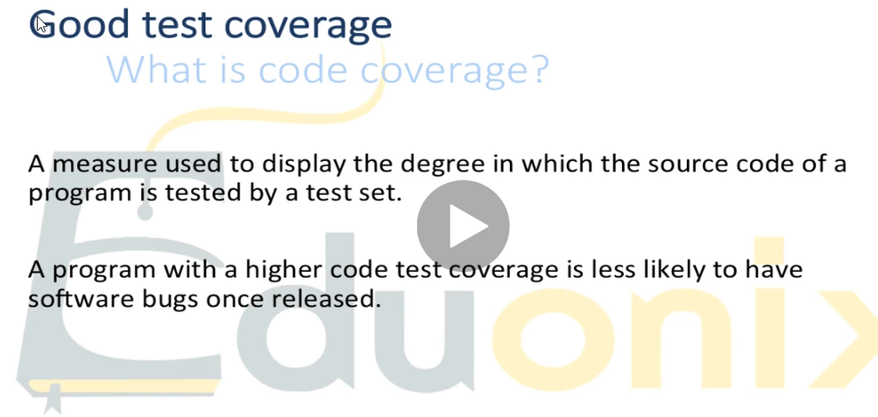

Slide 4
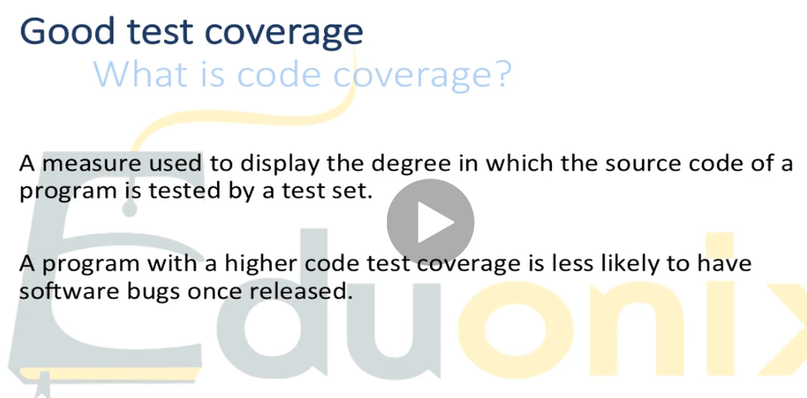

Slide 5
